Slide 1
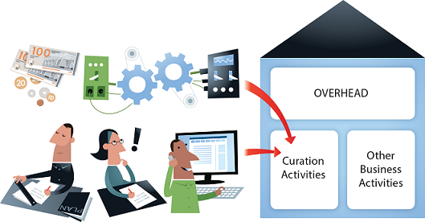
Capturing and communicating the value and economic impact of social science data services
Illustration by Jørgen Stamp digitalbevaring.dk CC BY 2.5 Denmark
CESSDA Workshop Lisbon May 2017 - Neil Beagrie (Charles Beagrie Ltd)

Slide 2
CESSDA SaW cost-benefit advocacy toolkit
(released 27/04/2017)
Notes:
Toolkit focuses on economic methods for assessing impact – other complementary approaches (non-economic) such as data citation analysis

Slide 3
Presentation Overview
Measuring Value and Impact of Research Data Infrastructure (focussing on cost-benefit)
ESDS Impact Study
CESSDA SaW Toolkit User requirements survey
Key evidence from Cost-Benefit Advocacy Toolkit

Slide 4
Previous Work
Big Science and Innovation Study for BIS July 2013
Desk review of c. 100 studies internationally;
3 studies highlighted to BIS as being particularly good examples of ‘good practice’ in the measurement of economic impacts:
Berkeley Lab 2010
Human Genome Project 2011
Economic and Social Data Service 2012

Slide 5
Why measure value and (economic) impact?
Advocacy: proving (to non-researchers) that current services or future services are a worthwhile investment;
Complementary to other approaches such as data/article citation analysis;
Can show more of the impact on research, teaching & learning, etc.
Note however:
It is challenging to do;
Methods well-established but impact data hard to obtain and to use.

Slide 6
John Houghton + Neil Beagrie 4 joint studies to date. 5th in progress. Methods applied to: Economic & Social Data Service (ESDS) Archaeology Data Service British Atmospheric Data Centre European Bioinformatics Institute Swiss Institute of Bioinformatics (in progress)
Value + Impact Analysis of Data Services
Notes:
4 studies of which ESDS was the first. Methods have continued to evolve. Each data service has disciplinary and operational differences and challenges – new insights from each of them so valuable to consider the other studies alongside ESDS even though ESDS is most relevant to other social science data archives.

Slide 7
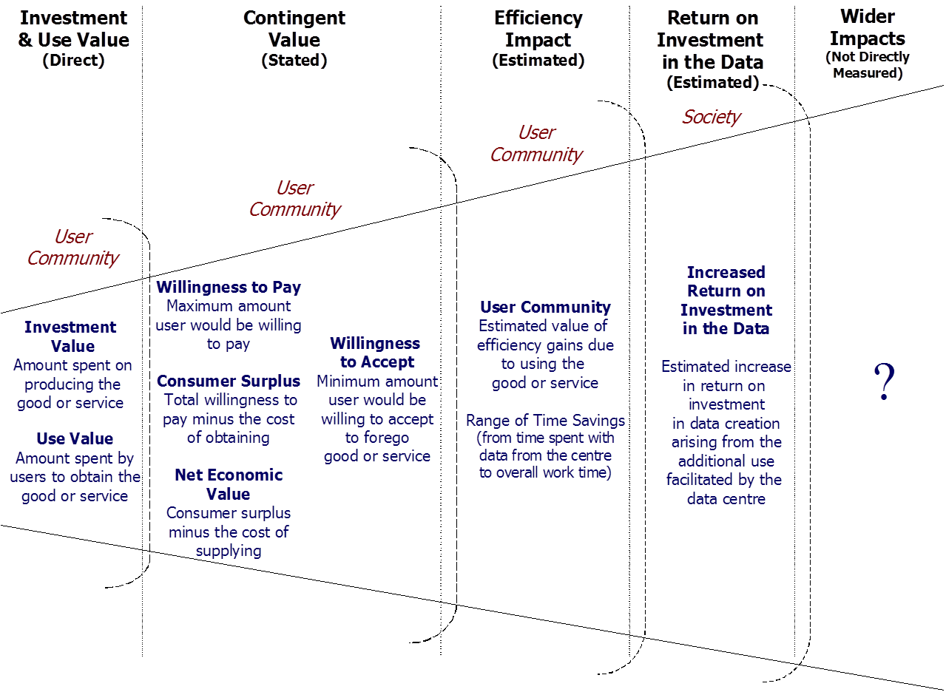
Best Practice from ESDS study
Applies range of methods;
Includes counter-factual;
Data collection tailored to different stakeholders: depositors, users, research, teaching;
Data weighting - survey value responses weighted to reflect the overall pattern of use from weblogs;
Case studies/ KRDS benefits illustrate benefits and impact pathways.

Slide 8
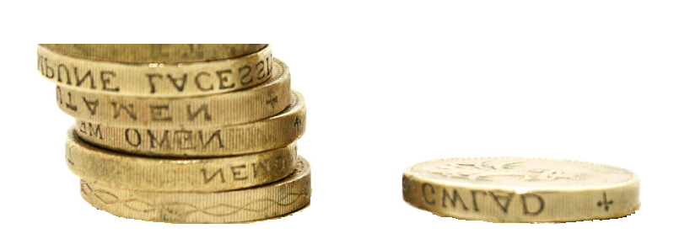
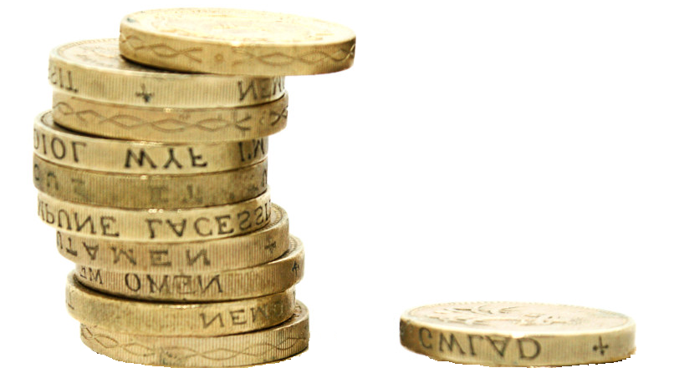
ESDS Study: Return on Investment (ROI) (ROI - service) Benefit/cost ratio of net economic value to ESDS operational costs 5.4 to 1 (ROI - research data creation) scenarios -Increase in returns on investment in data creation arising from additional use facilitated by ESDS -counterfactual up to 10 to 1

Slide 9
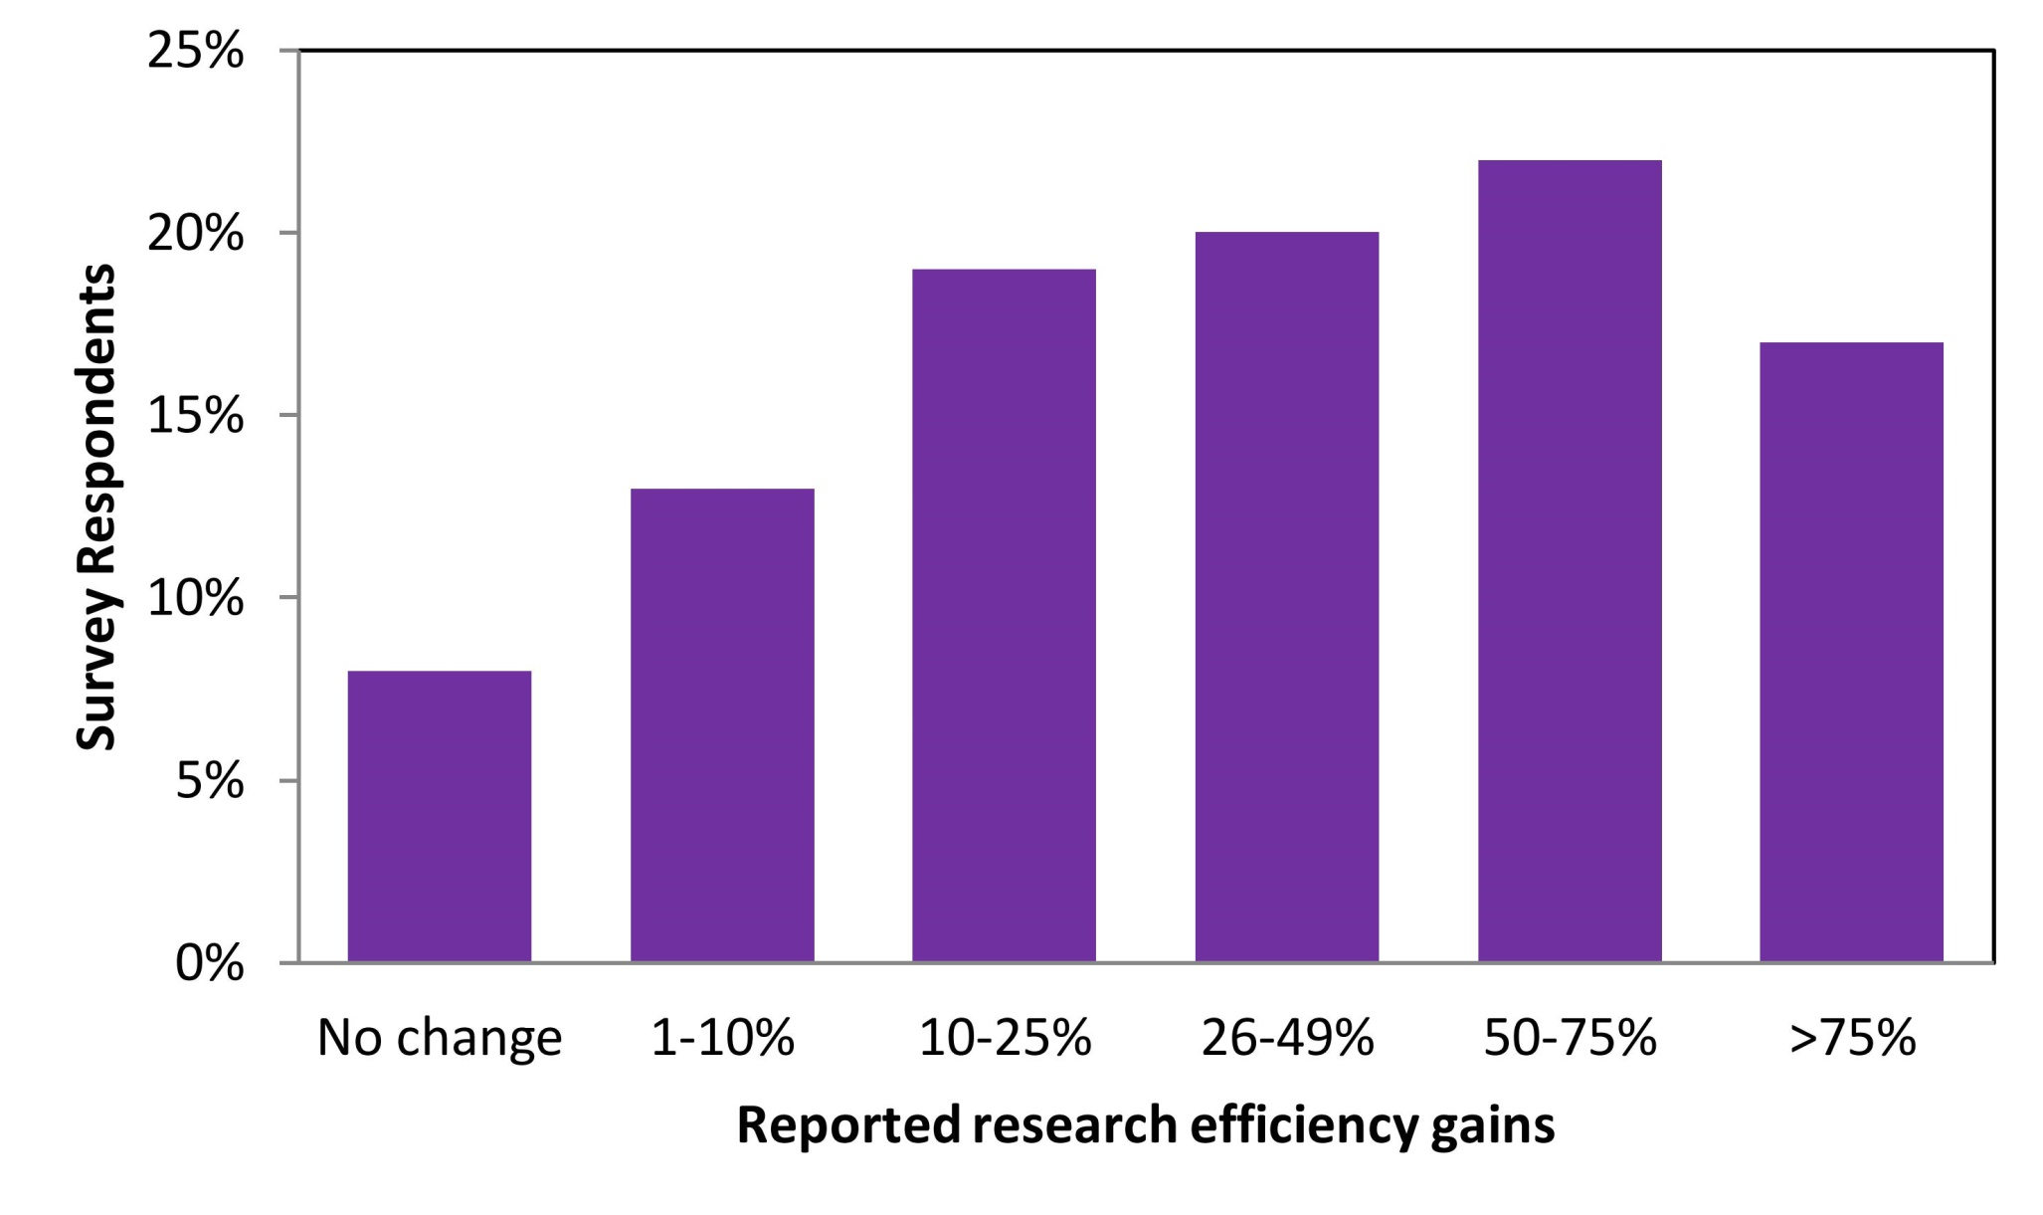
ESDS Study: Researcher Efficiency Gains
Impact of using ESDS data and services on research efficiency
(after Beagrie et al 2012, p77, Figure 15)
Economic and Social Research Council © 2012 CC-BY licensed

Slide 10
ESDS Study: Context
UK Data Archive one of the largest European social science data archives: perhaps the largest
UK Data Archive established for 40 years: has built up collections and users over time
Only economic impact study for any social science data archive to date
How to extend work for other social science archives?

Slide 11
CESSDA-SaW
User Requirements Survey

Slide 12
Survey Q1
IN WHICH COUNTRY IS THE DATA SERVICE BASED?
Notes:
Online survey invitation sent to 23 European countries – 100% response rate

Slide 13
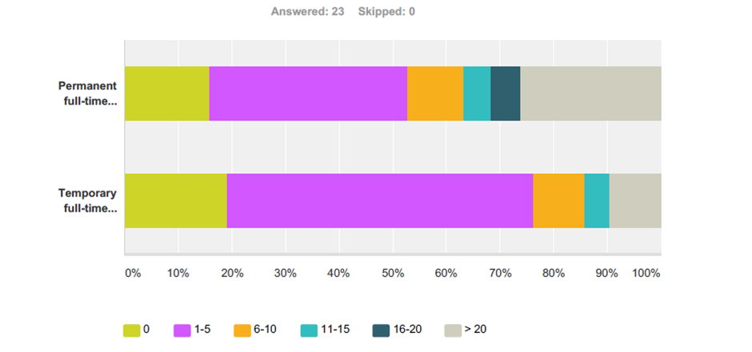
Survey Q2
THE DATA SERVICE'S CURRENT STAFFING IS APPROXIMATELY:
Notes:
Majority of respondents have very small staffing. Wide range of resources and capabilities for toolkit to address

Slide 14
Toolkit Responses

Slide 15
Design criteria
Easy for overloaded individuals/ smaller services
Short documents
Good Infographics
Synthesis
Making existing tools easier to use/tailored to (social science) data services
Creative Commons CC-BY wherever possible for ease of re-use

Slide 16
Toolkit Components
Factsheets
ROI, Benefits, Costs
Worksheets
Benefits Summary for a Data Archive
Archive Development Canvas
Case studies
ADP, FSD, LiDA, UKDS
Selected External Tools
CCeX, KRDS, CDMA, ESDS Impact, ADP surveys , etc
User Guide

Slide 17
Key evidence in the Factsheets

Slide 18
Data Infrastructure is an appreciating asset (in contrast to physical infrastructure which depreciates)

Slide 19
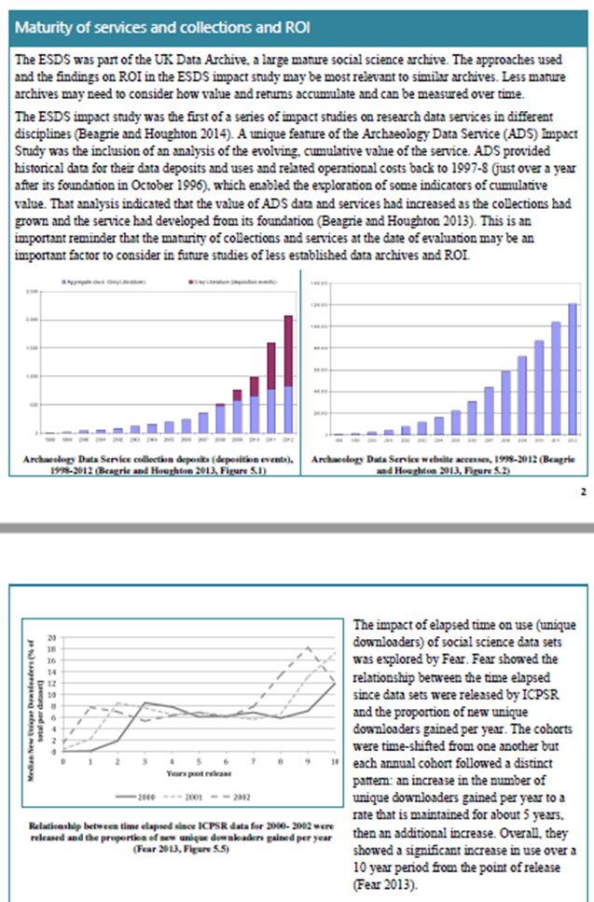
Appreciating Assets (from CESSDA SaW Cost-Benefit Advocacy Toolkit ROI Factsheet)

Slide 20
Counter-factuals – “Costs of Inaction”
“Ideally, economic impact assessments should estimate the counterfactual – i.e. what would occur in the absence of the facility…However, counterfactuals are rarely addressed in the [c.100] studies reviewed due to lack of data. We found two exceptions that address this issue partially. One is the evaluation of the economic impacts of ESDS (2012) which partially explores the counterfactual through a users’ survey…Another exception is a review of economic impacts of large-scale science facilities in the UK (SQW, 2008) … however, this estimation is not done rigorously and relies mostly on the estimation of the local benefits.”
Big Science and Innovation - Report to BIS - Technopolis 2013

Slide 21
ROI Factsheet – costs of inaction

Slide 22
Data Archives have high efficiency gains for research, teaching and learning

Slide 23
Benefits Factsheet (4)

Slide 24
Cost-benefit advocacy toolkit
http://dx.doi.org/10.18448/16.0013
neil@beagrie.com
website: www.cessda.net / twitter: @CESSDA_Data

