Slide 1
Changes in the DSA Guidelines
CESSDA SaW Training on Trust, Identifying Demand & Networking
The Hague, 16-17 June 2016
Natascha Schumann
GESIS Data Archive

Slide 2
Overview
Different Structure
Compliance Level
Old Guidelines vs new and common Requirements

Slide 3
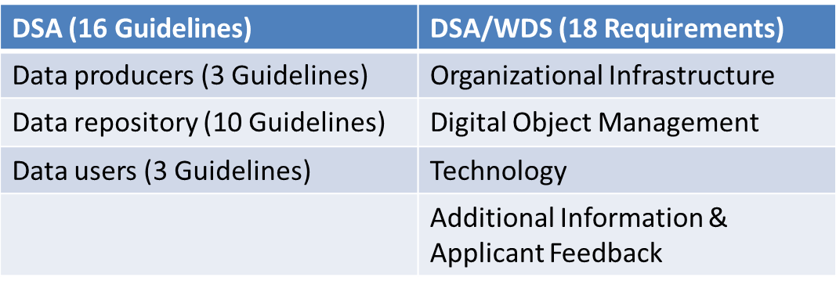
Structure

Slide 4
Compliance Level
0 – Not applicable
1 – The repository has not considered this yet
2 – The repository has a theoretical concept
3 – The repository is in the implementation phase
4 – The guideline has been fully implemented in the repository
.

Slide 5
General remarks
There is no one-to-one compare betweeen the guidelines/requirements
All aspects part of the DSA are also part of the new requirements
Some topics are emphazided within the new requirements
Different arrangement of guidelines and new weighting
No offical mapping, but personal impressions from a user perspective

Slide 6
No | DSA/WDS | DSA
0 | Brief Description of the Repository’s Designated Community | (0) Repository Context
1 | I. Mission/Scope The repository has an explicit mission to provide access to and preserve data in its domain. | (4) The data repository has an explicit mission in the area of digital archiving and promulgates it.
2 | II. Licenses The repository maintains all applicable licenses covering data access and use and monitors compliance. | (9) The data repository assumes responsibility from the data producers for access and availability of the digital objects. (14) The data consumer complies with access regulations set by the data repository. (16) The data consumer respects the applicable licences of the data repository regarding the use of the research data.
3 | III. Continuity of access The repository has a continuity plan to ensure ongoing access to and preservation of its holdings. | (4) The data repository has an explicit mission in the area of digital archiving and promulgates it.

Slide 7
No | DSA/WDS | DSA
4 | IV. Confidentiality/Ethics The repository ensures, to the extent possible, that data are created, curated, accessed, and used in compliance with disciplinary and ethical norms. | (5) The data repository uses due diligence to ensure compliance with legal regulations and contracts, including, when applicable, regulations governing the protection of human subjects. (15) The data consumer conforms to and agrees with any codes of conduct that are generally accepted in higher education and scientific research for the exchange and proper use of knowledge and information.
5 | V. Organizational infrastructure The repository has adequate funding and sufficient numbers of qualified staff managed through a clear system of governance to effectively carry out the mission. | $\sim$(4) The data repository has an explicit mission in the area of digital archiving and promulgates it. ~(8) Archiving takes place according to explicit workflows across the data life cycle.
6 | VI. Expert guidance The repository adopts mechanism(s) to secure ongoing expert guidance and feedback (either in-house, or external, including scientific guidance, if relevant). | (5) The data repository uses due diligence to ensure compliance with legal regulations and contracts, including, when applicable, regulations governing the protection of human subjects. (13) The technical infrastructure explicitly supports the tasks and functions described in internationally accepted archival standards like OAIS.
7 | VII. Data integrity and authenticity The repository guarantees the integrity and authenticity of the data. | (11) The data repository ensures the integrity of the digital objects and the metadata. (12) The data repository ensures the authenticity of the digital objects and the metadata.

Slide 8
No | DSA/WDS | DSA
8 | VIII. Appraisal The repository accepts data and metadata based on defined criteria to ensure relevance and understandability for data users. | ~(2) The data producer provides the research data in formats recommended by the data repository. ~(3) The data producer provides the research data together with the metadata requested by the data repository. ~(6) The data repository applies documented processes and procedures for managing data storage. ~(8) Archiving takes place according to explicit workflows across the data life cycle.
9 | IX. Documented storage procedures The repository applies documented processes and procedures in managing archival storage of the data. | (6) The data repository applies documented processes and procedures for managing data storage.
10 | X. Preservation plan The repository assumes responsibility for long-term preservation and manages this function in a planned and documented way. | (1) The data producer deposits the research data in a data repository with sufficient information for others to assess the scientific and scholarly quality of the research data and compliance with disciplinary and ethical norms. (5) The data repository uses due diligence to ensure compliance with legal regulations and contracts, including, when applicable, regulations governing the protection of human subjects.

Slide 9
No | DSA/WDS | DSA
11 | XI. Data quality The repository has appropriate expertise to address technical data and metadata quality and ensures that sufficient information is available for end users to make quality-related evaluations. | The data producer deposits the research data in a data repository with sufficient information for others to assess the scientific and scholarly quality of the research data and compliance with disciplinary and ethical norms. (3) The data producer provides the data together with the metadata requested by the data repository. (10) The data repository enables the users to utilize the research data and refer to them.
12 | XII. Workflows Archiving takes place according to defined workflows from ingest to dissemination. | (8) Archiving takes place according to explicit workflows across the data life cycle.
13 | XIII. Data discovery and identification The repository enables users to discover the data and refer to them in a persistent way through proper citation. | (10) The data repository enables the users to utilize the research data and refer to them.
14 | XIV. Data reuse The repository enables reuse of the data over time, ensuring that appropriate metadata are available to support the understanding and use of the data. | (7) The data repository has a plan for long-term preservation of its digital assets. (10) The data repository enables the users to utilize the research data and refer to them.

Slide 10
No | DSA/WDS | DSA
15 | XV. Technical infrastructure The repository functions on well-supported operating systems and other core infrastructural software and is using hardware and software technologies appropriate to the services it provides to its Designated Community. | (13) The technical infrastructure explicitly supports the tasks and functions described in internationally accepted archival standards like OAIS.
16 | XVI. Security The technical infrastructure of the repository provides for protection of the facility and its data, products, services, and users. | (13) The technical infrastructure explicitly supports the tasks and functions described in internationally accepted archival standards like OAIS.
17 | XVII. Additional information Any other relevant information you wish to provide on your repository
18 | XVIII. Applicant feedback The DSA–WDS Catalogue of Common Requirements is not seen as final, and we value your input to improve the basic certification procedure. To this end, please leave any comments you wish to make on both the quality of the Catalogue and its relevance to your organization, as well as any other related thoughts.

Slide 11
Examples
Almost one-to-one
Simplification
Concretisation

Slide 12
(Almost) One-to-One
R9: The repository applies documented processes and procedures in managing archival storage of the data.
GL6: The data repository applies documented processes and procedures for managing data storage.

Slide 13
Simplification
II. Licenses: The repository maintains all applicable licenses covering data access and use and monitors compliance.
GL9: The data repository assumes responsibility from the data producers for access and availability of the digital objects.
GL14: The data consumer complies with access regulations set by the data repository.
GL16: The data consumer respects the applicable licences of the data repository regarding the use of the research data.

Slide 14
Concretisation
IV. Confidentiality/Ethics: The repository ensures, to the extent possible, that data are created, curated, accessed, and used in compliance with disciplinary and ethical norms.
GL5: The data repository uses due diligence to ensure compliance with legal regulations and contracts, including, when applicable, regulations governing the protection of human subjects.
GL15: The data consumer conforms to and agrees with any codes of conduct that are generally accepted in higher education and scientific research for the exchange and proper use of knowledge and information.

Slide 15
Summary
No change of contents
New structure:
Like the standards within the framework
Easier to go through
Stronger emphasis on documented procedures and plans
Clear labeling of the requirements

