Slide 1

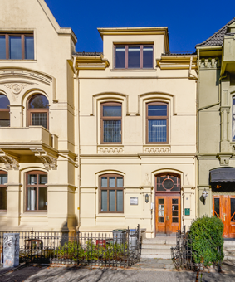

Webinar 2
Research Data Management
23rd of June, 2016
Irena Vipavc Brvar, Sonja Bezjak (Social Science Data Archives)
This work is licensed under a Creative Commons Attribution 4.0 International License.

Slide 2
CESSDA
Legal entity owned and financed by the individual member states & represented by a national institution, a Service Provider
Recognized as an ESFRI Landmark in the ESFRI 2016 Roadmap in the field of social and cultural innovation
Aiming to facilitate access to social science data resources for researchers regardless of the location of researcher or data.

Slide 3
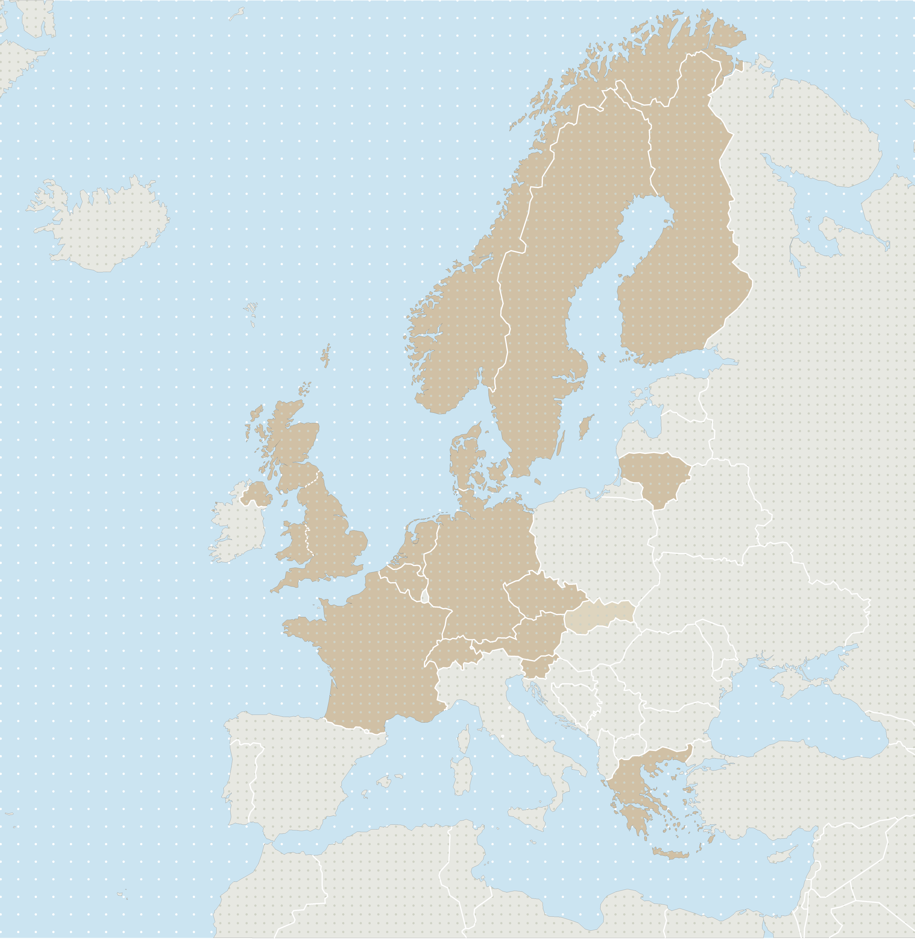
15 CESSDA members
Austria
Belgium - SOHDA
Czech Republic - CSDA
Denmark - DDA
Finland - FSD
France - PROGEDO/Réseau Quetelet
Germany - GESIS
Greece - So.Da.Net
Lithuania - LiDA
Netherlands - DANS
Norway - NSD
Slovenia - ADP
Sweden - SND
Switzerland - FORS
UK - UKDS
1 observer
Slovakia - SASD (observer)

Slide 4


CESSDA’s European project
Strengthening and widening the European infrastructure for social science data archives
The aims are to:
achieve full European coverage
strengthen the network and
to ensure sustainability of its data for the widened network.

Slide 5
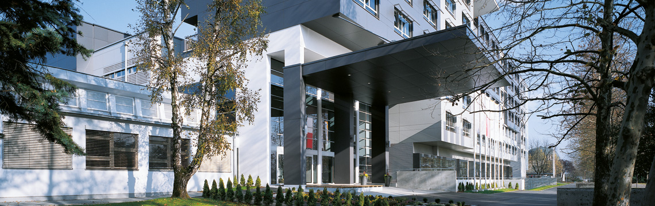
Slovenian Social Science Data Archives
Arhiv družboslovnih podatkov (ADP)
http://www.fdv.uni-lj.si/
Established in 1997
Member of CESSDA since 1998, national SP
National repository for social sciences
Supporting RDM in Slovenia

Slide 6
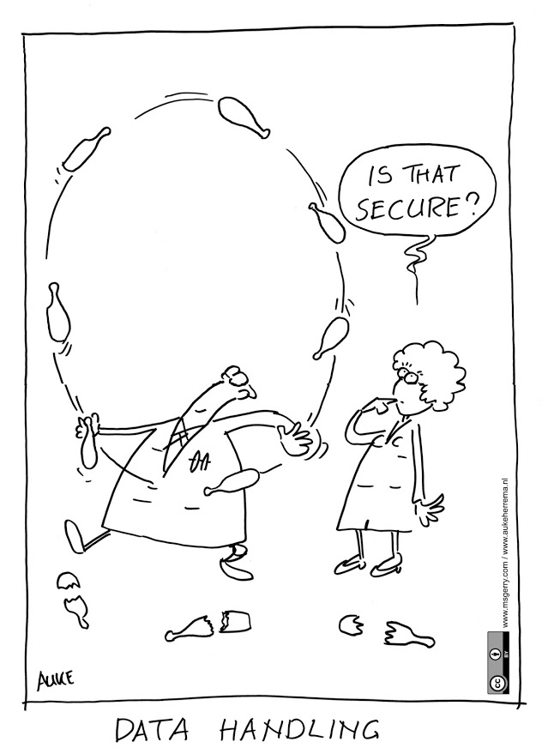
Content
Definition(s) of RDM and DMP
Benefits and Advantages of RDM
Research Data Life-Cycle
Structure and Components of DMP
Stakeholders

Slide 7
Purpose of webinar
Webinar is meant for future trainers to provide them with general information on RDM and DMP.
Presentation contains different sources supporting RDM.
We will share experience from seminars, workshops and discussions with various stakeholders.

Slide 8
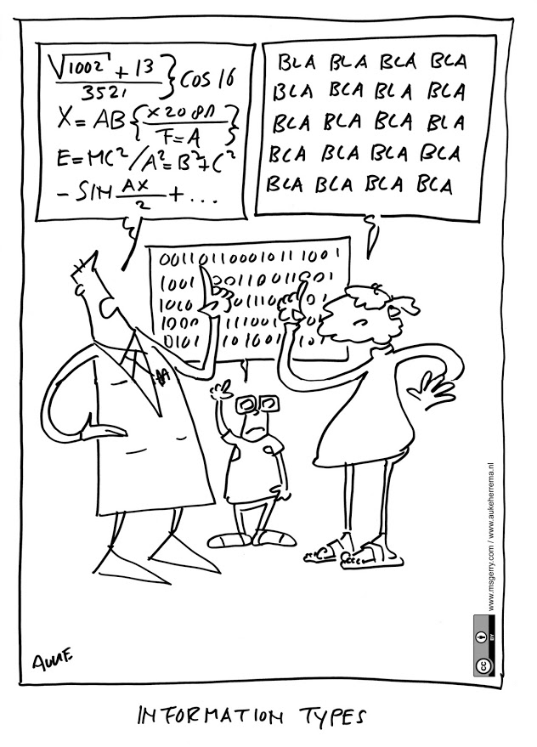
Target audience
Researchers
Students
Librarians
Research Offices
Other

Slide 9
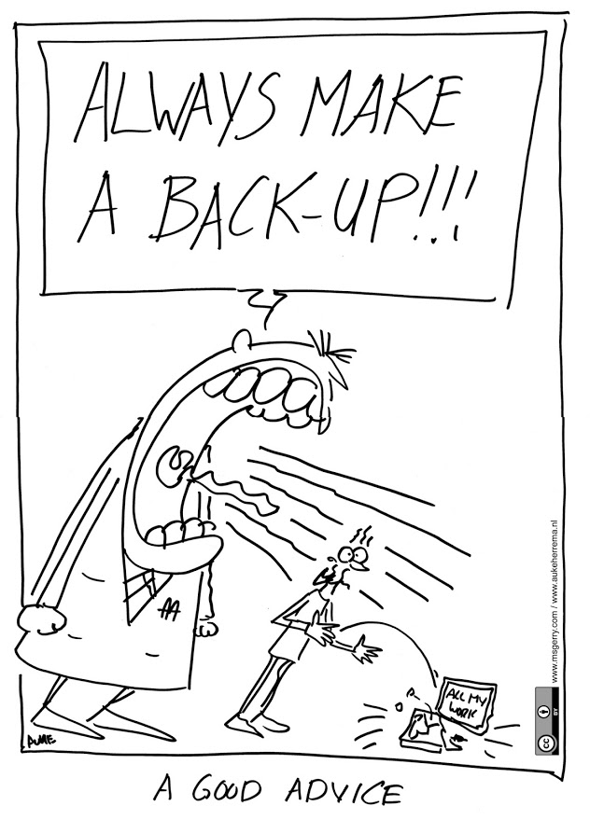
Raising awareness
Organizing workshops
Organizing webinars
Preparing RDM materials: guides, tools…
Promoting webinars, workshops
Organizing round tables, conferences, discussions…

Slide 10
Poll
Put yourself in the shoes of researchers in your country. Which is the most important reason to share research data:
Funders requirement
Scientific journal requirements
Principles of scientific research – culture of sharing
Collaboration with other researches – raising impact of your work

Slide 11
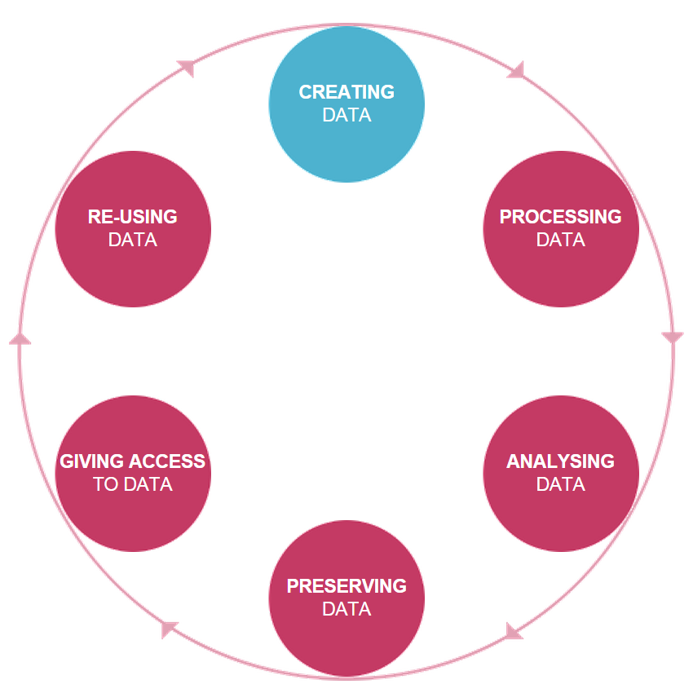
Definition of Research Data Management
Data management covers all aspects of handling, organizing, documenting and enhancing research data. (UKDA)
UKDA

Slide 12
Definition of RDM
Research data management entails that data and related metadata are created, preserved and organized in a manner which ensures that data remain accessible and reliable, and data protection and security are maintained over the whole data life cycle. (FSD)

Slide 13
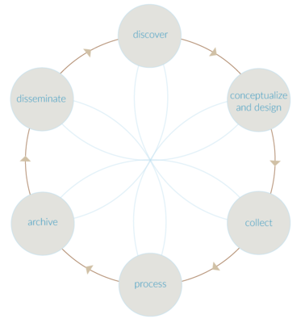
Research Data Life-Cycle
CESSDA

Slide 14
Research Data Life-Cycle
For the effective management of data, planning starts when research is being designed and should consider both how data will be managed during the research and how they will be shared afterwards. (UKDS)

Slide 15

Benefits and Advantages of RDM
It is a vital step in your research process that you cannot afford to skip.
It helps you ensure your research data are accurate, complete, reliable, and secure both during and after you complete your research.
(MANTRA)

Slide 16
Benefits and Advantages of RDM
Good data management is fundamental for high quality research data and research excellence.
Well organised, well documented, preserved and shared data are invaluable to advance scientific inquiry and to increase opportunities for learning and innovation. (UKDA)

Slide 17
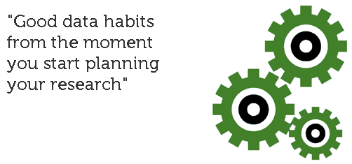
Benefits and Advantages of RDM
It is particularly important for facilitating data sharing, ensuring the sustainability and accessibility of data in the long-term, and allowing data to be re-used for future science. (UKDS)
https://www.ukdataservice.ac.uk/manage-data

Slide 18
Definition of Data Management Planning
A data management plan is a formal document you develop at the start of your research project which outlines all aspects of your data (i.e., what you will do with your data during and after your research project. (MANTRA)

Slide 19
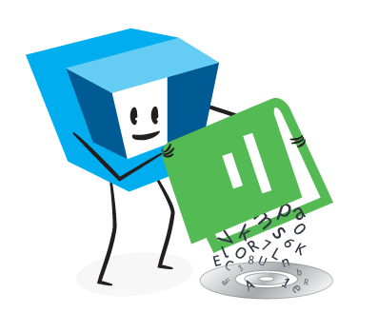
Definition(s) of DMP
A data management plan describes how research data are collected or created, how data are used and stored during research and how made accessible for others after the research has been completed. (FSD)
http://www.fsd.uta.fi/aineistonhallinta/en/

Slide 20
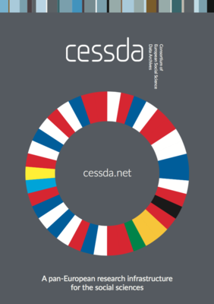
Definition(s) of DMP
A research data management plan describes strategies for the collection, storage, validation, security, preservation, and sharing of data where possible, throughout the data lifecycle. (CESSDA)

Slide 21
Definition(s) of DMP
The purpose of the Data Management Plan (DMP) is to provide an analysis of the main elements of the data management policy that will be used by the applicants with regard to all the datasets that will be generated by the project.
The DMP is not a fixed document, but evolves during the lifespan of the project. (H2020)

Slide 22
Structure and Components of DMP
It must cover:
the handling of research data during & after the project
what data will be collected, processed or generated
what methodology & standards will be applied
whether data will be shared / made open access & how
how data will be curated & preserved (H2020)

Slide 23
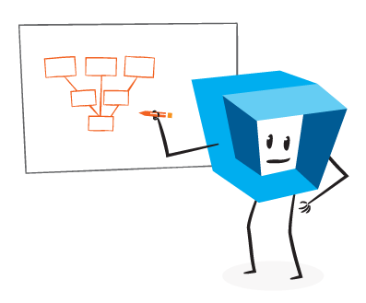
Structure and Components of DMP
The data
Rights
Confidentiality and data security
File formats and programs
Documentation on data processing and content
Life cycle
Data management plan models (FSD)

Slide 24
Structure and Components of DMP
Assessment of existing data
Information on new data
Quality assurance of data
Backup and security of data
Management and curation of data
Difficulties in data sharing and measures to overcome these
Consent, anonymisation and strategies to enable further re-use of data
Copyright and Intellectual Property ownership
Responsibilities (UKDS for ESRC researchers)

Slide 25
DMP checklists
UKDS data management checklist can point you to key matters to consider in a data management and sharing plan.
DCC list of questions and guidance that researchers may find useful when writing data management and sharing plans

Slide 26
UKDS DM checklist (part)
Do your data contain confidential or sensitive information? If so, have you discussed data sharing with the respondents from whom you collected the data?
Are you gaining (written) consent from respondents to share data beyond your research?
Do you need to anonymise data, e.g. to remove identifying information or personal data, during research or in preparation for sharing?

Slide 27
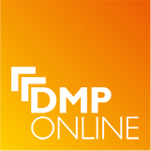
DM & DMP Tools
Check on national, institutional level
Check with funder
DMPonline at DCC
DCC form
WRITE and SHARE
CO-WRITING
EXPORTING

Slide 28
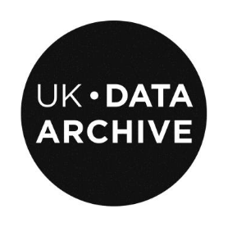
Stakeholders
It is crucial that roles and responsibilities are assigned and not simply presumed. For collaborative research, assigning roles and responsibilities across partners is important. (UKDA)

Slide 29
Stakeholders
Principal investigators designing research
Research staff or students collecting, creating, processing and analysing data
External contractors with a role in data collection, collation or processing, e.g. transcribers
Support staff managing and administering research
Institutional IT services providing data storage, security and back-up services
External data centres or archives who facilitate data sharing (UKDA)

Slide 30
POLL
Is there a data sharing policy in your county referring to open data?
Yes
Mature level of development
Beginning of development
No

Slide 31
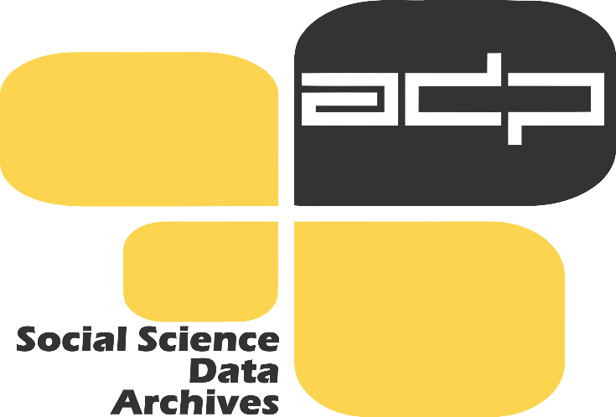
Funder supporting RDM
Manages national/disciplinary policies which require the preparation of DMPs as part of the research project application process, based on the principles of open access to research data financed by public funds, perceived as being a public good. (ADP)

Slide 32
Research institution supporting RDM
Assures and manages internal open access policies and designs procedures to help research projects with the preparation and implementation of DMPs.
Manages expert training for researchers and support staff.
Provides infrastructure in the form of technological and advisory services to provide digital preservation for data throughout the lifecycle (research offices, libraries, operating data centre and service networks).
Provides common services and tools to support research groups. (ADP)

Slide 33
Library supporting RDM
Provides information about the availability of existing data sources.
Provides information about options to deposit data in a data centre or data archive.
Helps select an appropriate or recommended data centre or data archive.
Provides information about open access conditions and advantages.
Supports preparation of formal DMPs.
Provides support with preparation of basic study metadata and documentation, authors‘ rights, and explains other deposition requirements. (ADP)

Slide 34
Data Center supporting RDM
Offers support with data management planning and preparation of data for open access
Evaluates the importance of research data for science and their long-term usability
Adopts an acknowledged digital curation approach
Provides access to data and enables searching and browsing through standard data descriptions for the purposes of discovery (ADP)

Slide 35
What should RDM training cover
Set the floor (about data sharing)
Research data (definition)
DMP and RDM
Available infrastructure and services
Hands-on on DMP and RDM

Slide 36
RDM training for doctoral students
Introduction to Open Science, Open Access and Open Data
Research Data Management Planning
Legal and ethical issues
Research Data Lifecycle: role of Data Services in a Data Lifecycle
Preparing data and documentation for digital curation (DDI, metadata, managing data file)
Deposit data to data centre / Repository
Have enough hands-on session. 3 – 5 days

Slide 37
RDM training for researchers
Broader EU context of open access in research
Slovenian research data policy
Introduction to RDM from the international perspective
Data management planning
Hands-on: how to use RDM tool
Managing and sharing research data: consent, confidentiality and disclosure
Hands-on: development of a general consent form
4 – 8 hours

Slide 38
RDM training for librarians
Open Access in European Union research activities
Introduction to Research Data Management (remote video-lecture from DCC team)
Data Librarian Experience (Stuart Macdonald, Edinburgh University)
The Role of Librarians in the Categorisation and Classification of Scientific Data Publications
Development of Research Data Policy and RDM Planning in Slovenia
Data Users and Data Depositors
Bibliography of researchers and evaluation of research work according to the methodology of the Slovenian Research Agency
Role of the ‘OSICD’ in evaluation of research work and cooperation with librarians (bibliographers)
4 – 8 hours
Request from librarians – provide concrete guidance and a lot of materials

Slide 39
RDM training for “institution”
Short 1-1,5 hour
Reserve at least 0,5 hour for discussion / consultation
Tailor-made - discipline specific (quali / quanti)
Different stakeholders are likely to attend (vice-dean for research, researchers, head of research center, research office, librarian etc.)

Slide 40
What else can trainer do?
Supporting researchers:
- to develop RDM training materials
- to translate RDM tools
- to develop a general consent form in your language and tailored for your discipline
Support for librarians:
- to develop disciplinary specific informational material for librarians (economy, psychology, political science ...)
- to inform them regularly about novelties in archives
Support for decision makers:
- active engagement in preparing research data policy on national level
- preparing policies and infrastructure on institutional level (Universities)
- preparing data sharing policies and citation standard with journal editors

Slide 41
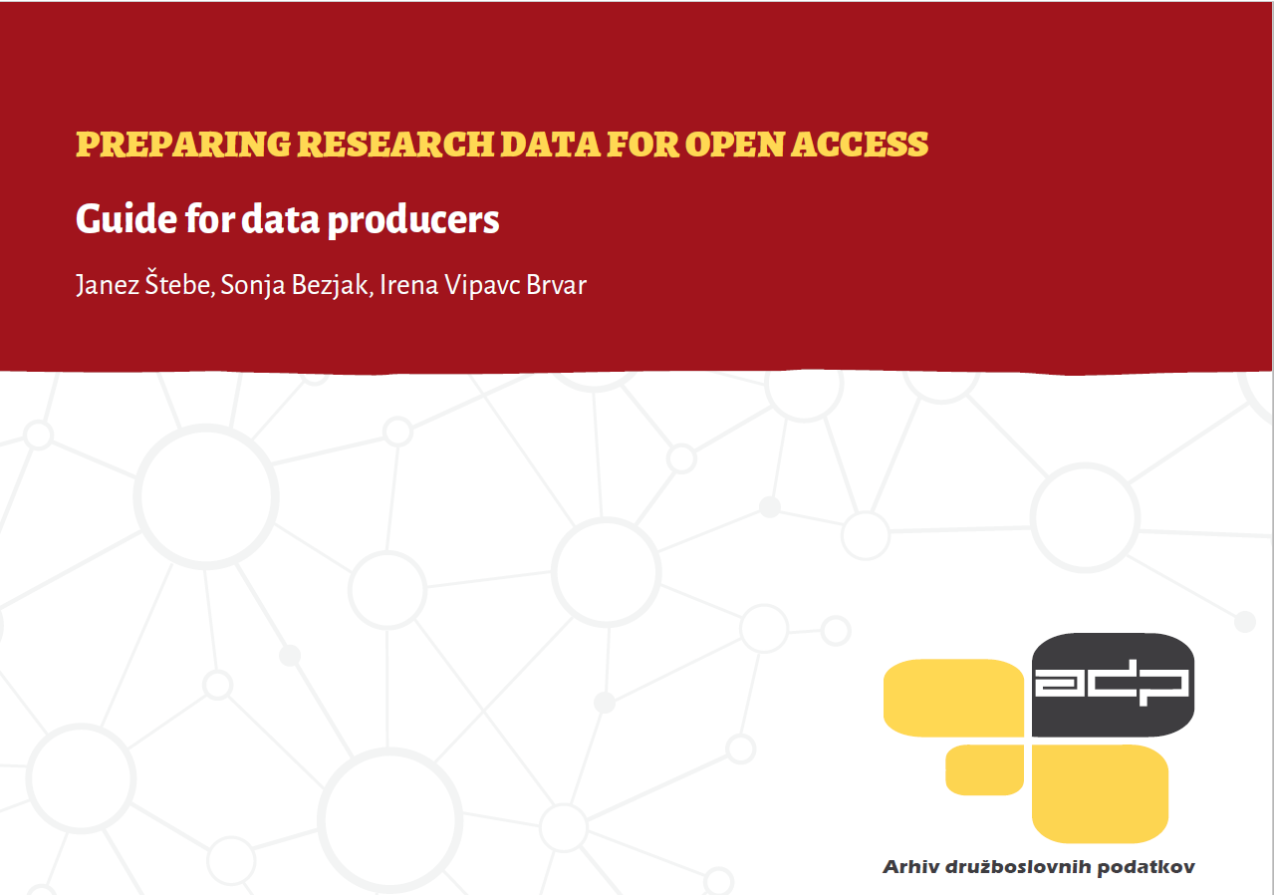
Training material
Štebe Janez, Sonja Bezjak, Irena Vipavc Brvar: Preparing research data for open access : guide for data producers (2015)
        URN:NBN:SI:DOC-G0DPXMZ

Slide 42
In short
Introduction to RDM training
Relevant sources (in these slides and hand-out)
Content and type of training depends audience (shown by examples)

Slide 43
thanks!
Irena Vipavc Brvar
Irena.Vipavc@fdv.uni-lj.si
Slovenian Social Science Data Archives (ADP)
Sonja Bezjak
Sonja.Bezjak@fdv.uni-lj.si
Slovenian Social Science Data Archives (ADP)
For more information on cessda training including webinars: training@cessda.net
website: http://cessda.net/CESSDA-Services/Projects/CESSDA-SaW
twitter: @CESSDA_Data

